Slide 1
Agentic ai Premalatha T

Slide 2

WHO AM I?
LinkedIn: https://www.linkedin.com/in/latha-t-k-b21018128/
Data Science ,AIML
Data Analysis ,SQL,Pyspark
Data Visualization ,PowerBI,Tableau
Natural Language Processing (NLP)
Computer Vision
Generative AI,Prompt Engineering
BigData and Data Engineering

Slide 3
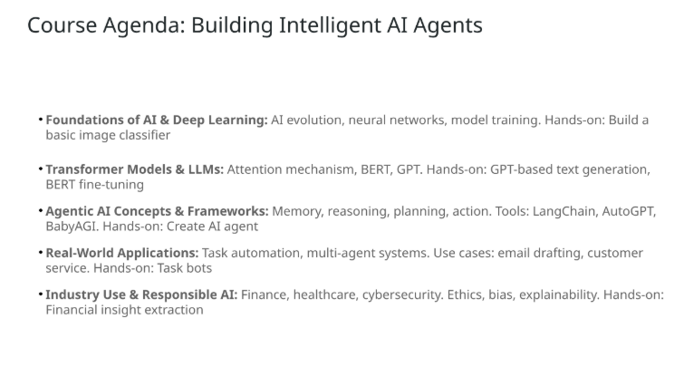

Slide 4
Agenda
What is ML,DL and AI
Steps in a ML Project
ML Techniques and Tools
DS Learning Path

Slide 5
Data?
Information and Noise(Insignificant information)
ML ,DS,AI-> Extract information(Exclude noise)

Slide 6
Types of Analytics
In today's data-driven world, information is king. But raw data itself isn't enough.
We need to analyze it to extract insights and make informed decisions

Slide 7
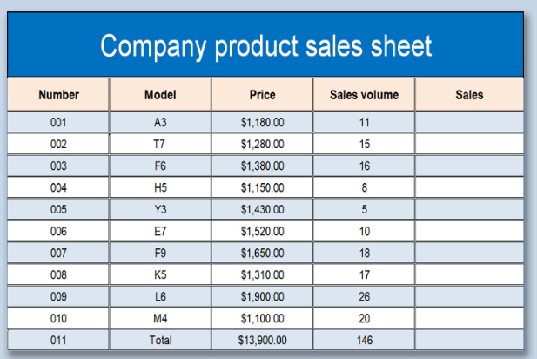
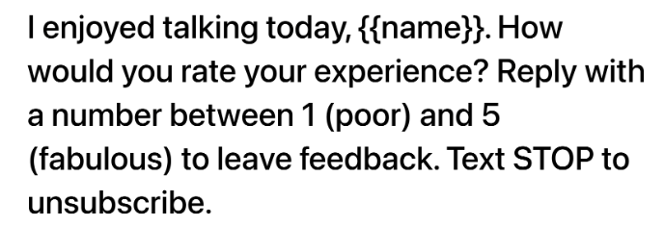

Slide 8
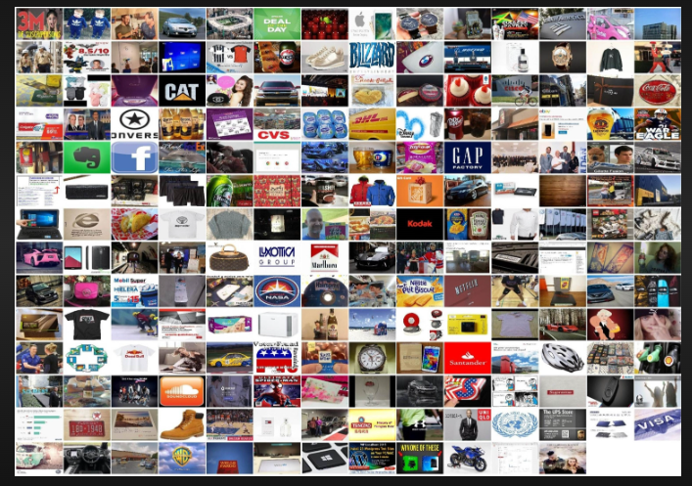
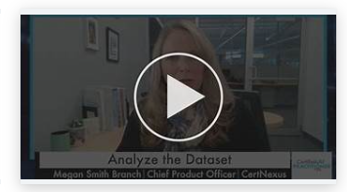
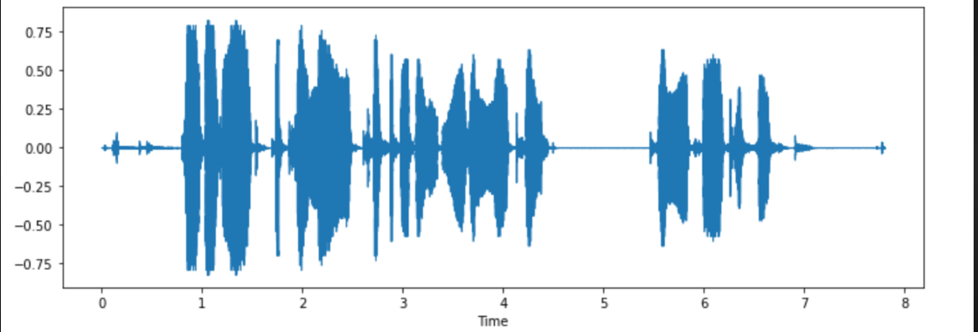

Slide 9






Slide 10
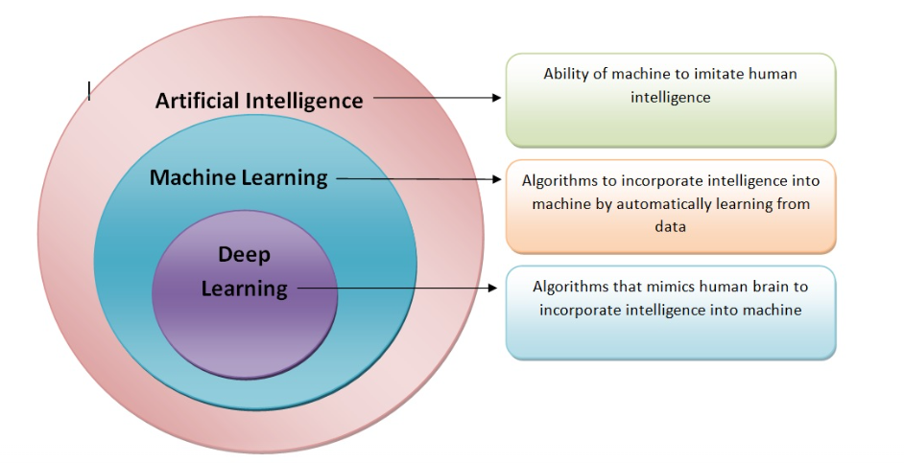

Slide 11
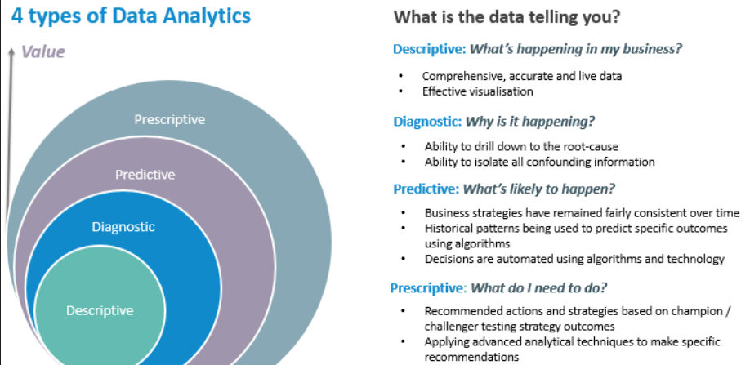

Slide 12
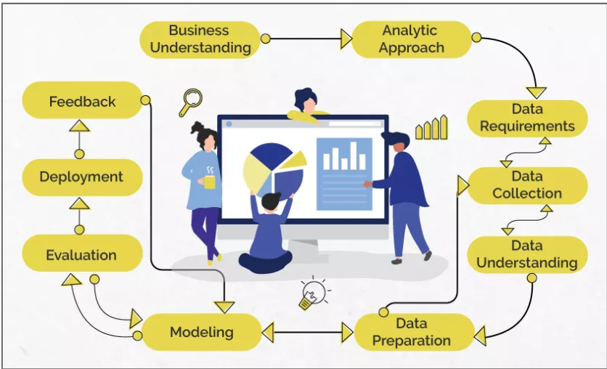
Data Science/Machine Learning

Slide 13
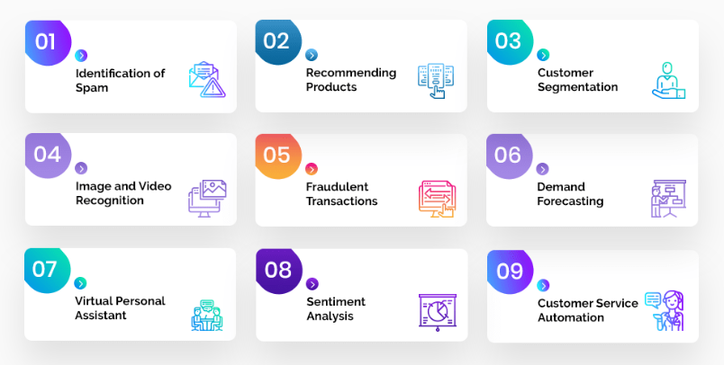
Problem Statement

Slide 14
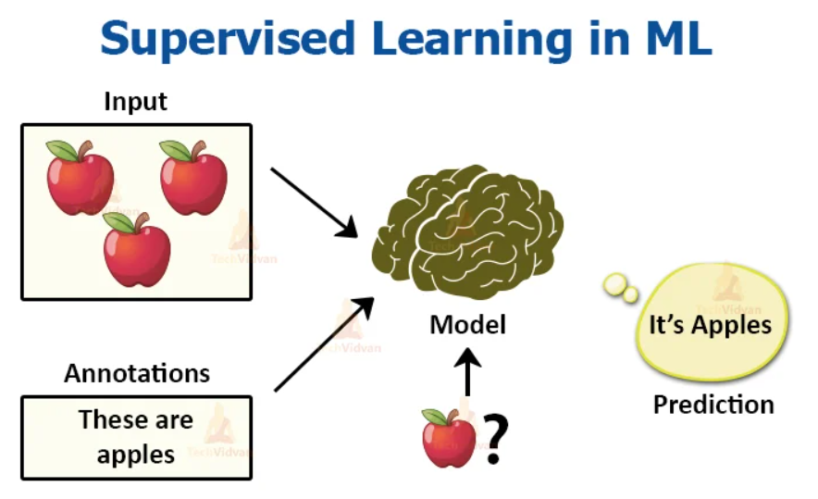
Analytic Approach

Slide 15
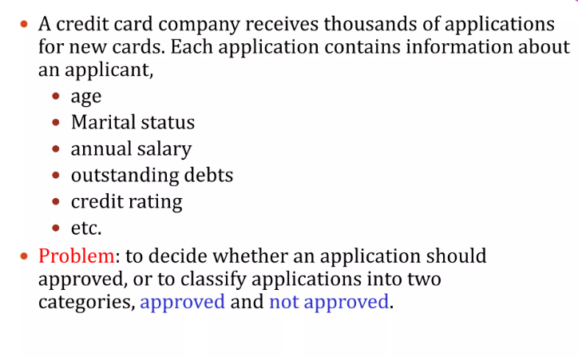
Supervised Learning

Slide 16
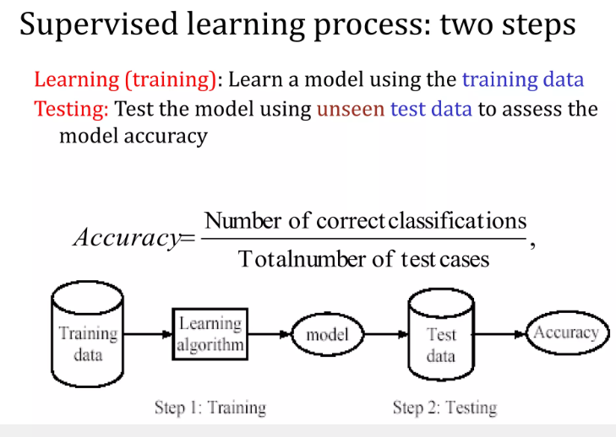

Slide 17
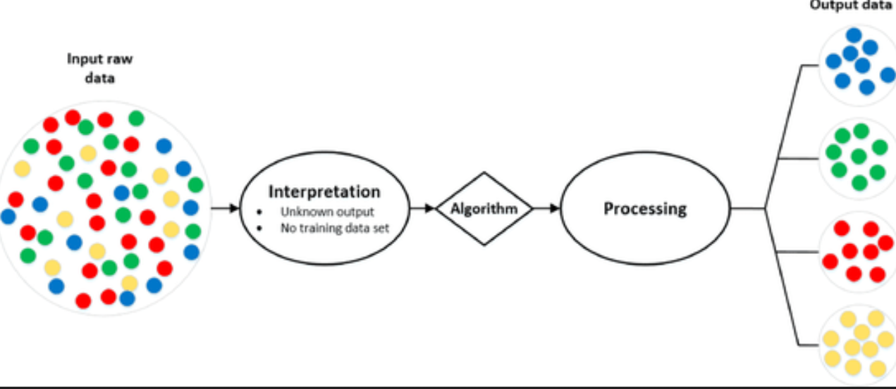
Analytic Approach

Slide 18
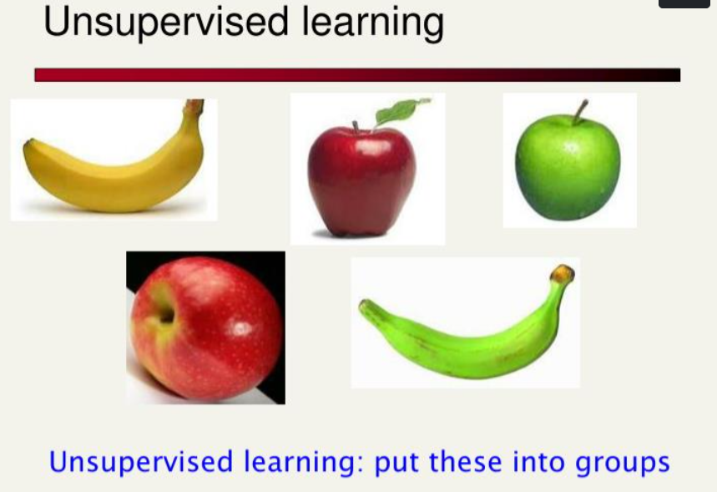

Slide 19
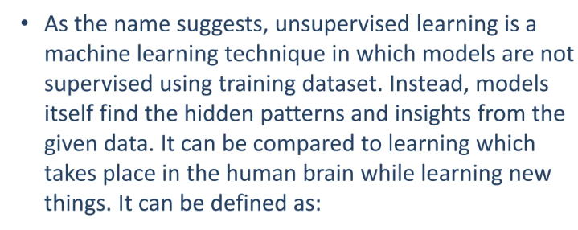

Slide 20
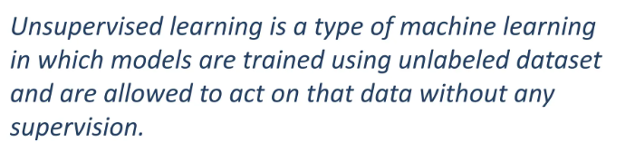

Slide 21
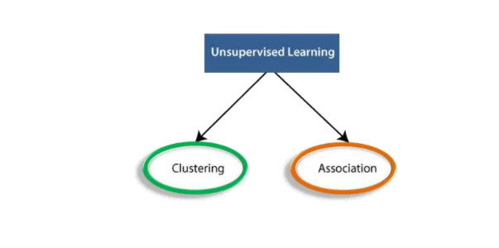

Slide 22
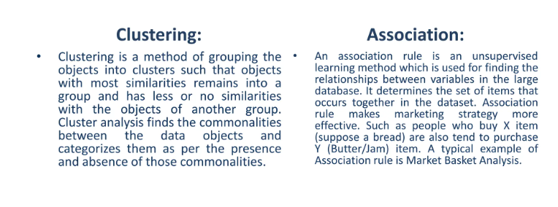

Slide 23
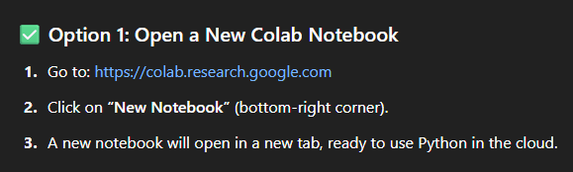

Slide 24
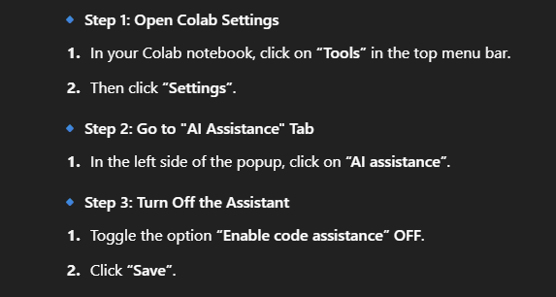

Slide 25
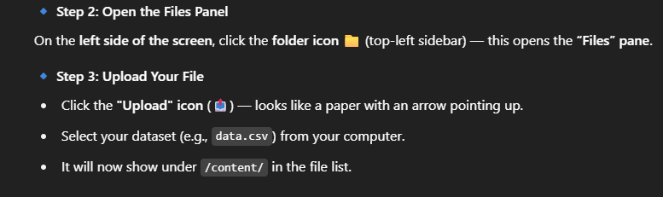

Slide 26
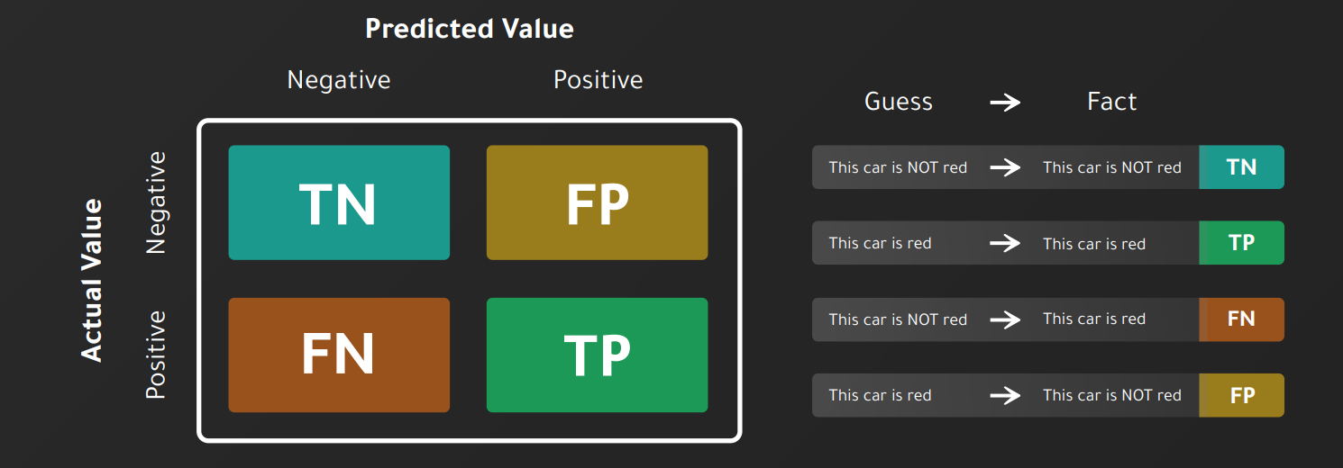

Slide 27
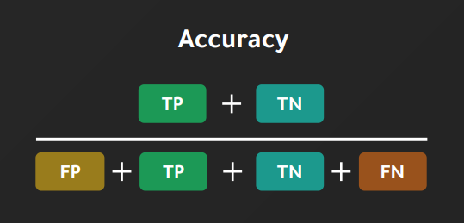

Slide 28
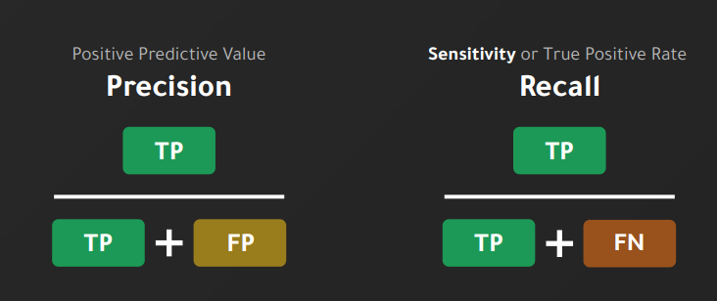

Slide 29
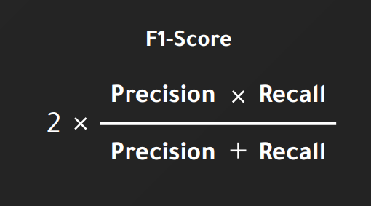

Slide 30
Questions ????

Slide 31
Day 1_Part2
Premalatha T

Slide 32
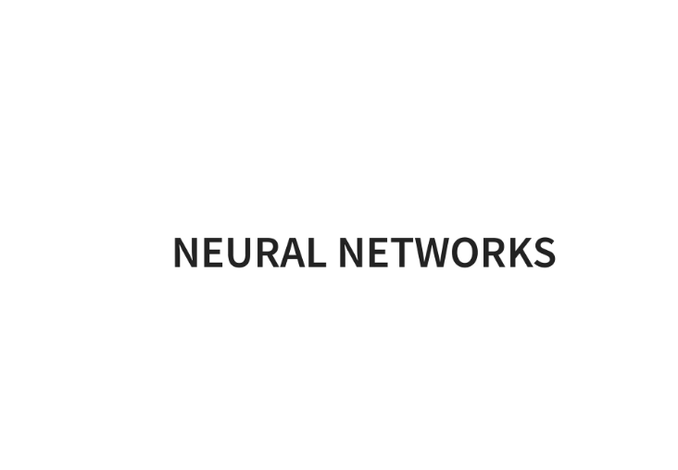

Slide 33
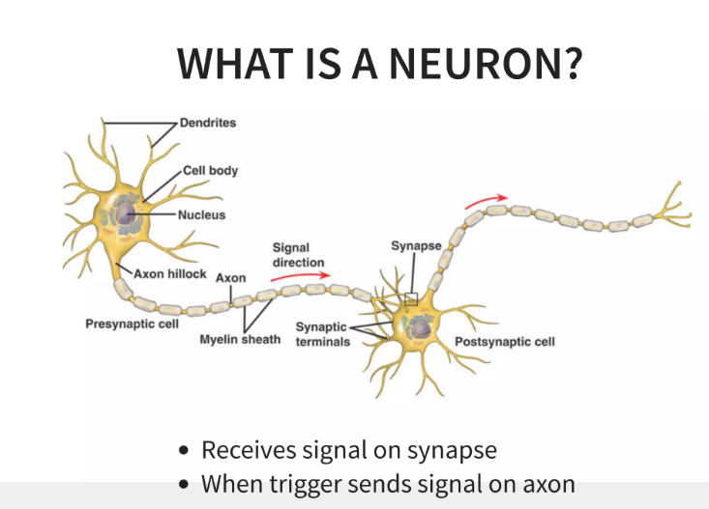

Slide 34
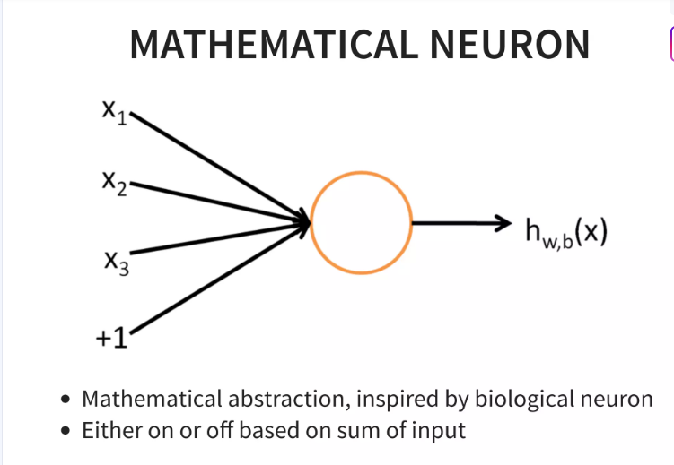

Slide 35
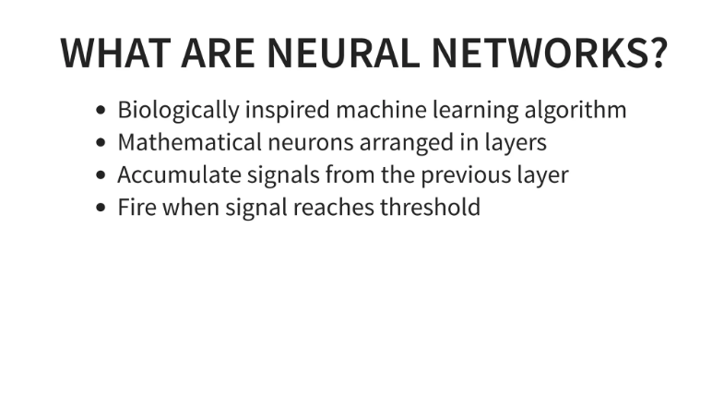

Slide 36
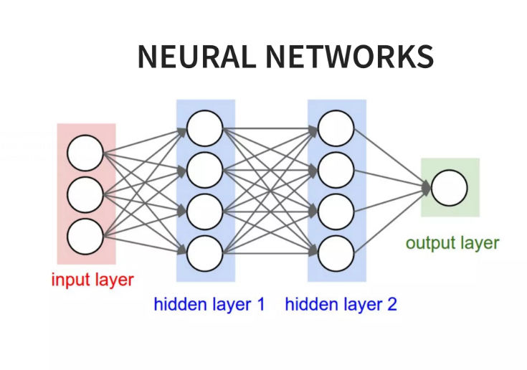

Slide 37
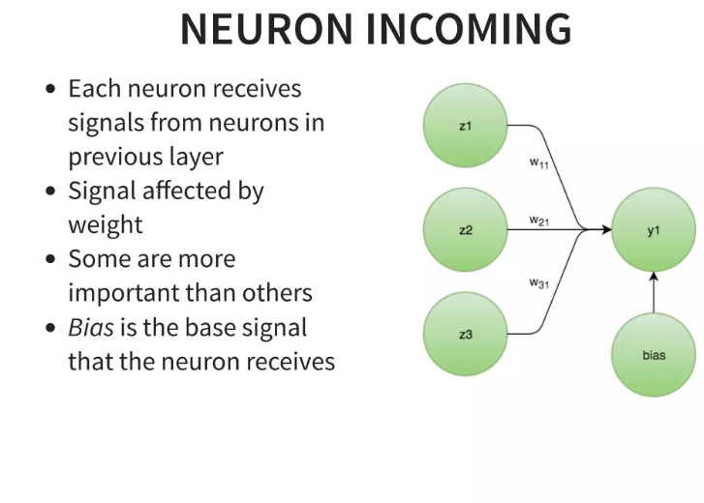

Slide 38
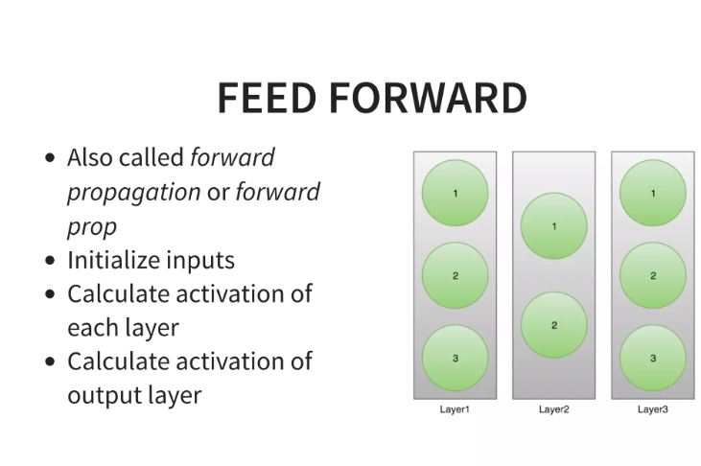

Slide 39
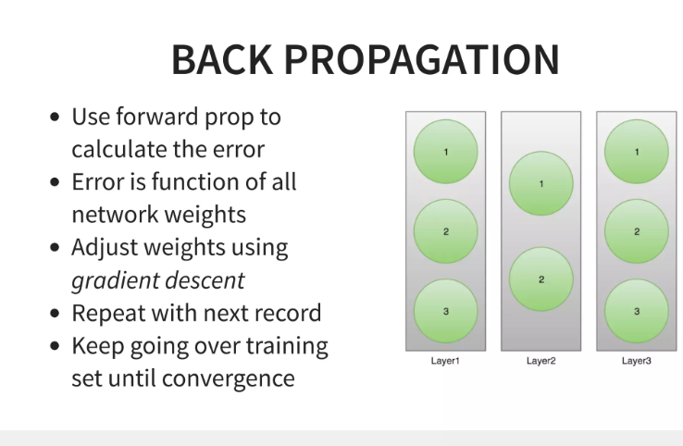

Slide 40
